Slide 1
Employee Data Analysis using Excel
STUDENT NAME: S.SARUMATHI
REGISTER NO:2213391042056, 35649979B23BA3592A849560D722E852
DEPARTMENT:BACHELOR OF COMMERCE(CORPORATE SECRETARYSHIP)
COLLEGE: QUEEN MARY’S COLLEGE

Slide 2
PROJECT TITLE
EMPLOYEE SALARY DATASET USING EXCEL

Slide 3


AGENDA
Problem Statement
Project Overview
End Users
Our Solution and Proposition
Dataset Description
Modelling Approach
Results and Discussion
Conclusion
3/21/2024 Annual Review

Slide 4

PROBLEM STATEMENT
Salary Distribution by Experience: Analyze how salaries vary with years of experience.
Gender Salary Gap: Compare the total salaries for female and male employees. Identify any noticeable differences in the total salary amounts attributed to each gender and investigate the implications of these differences.
Experience vs. Gender: Determine if certain experience levels are predominantly associated with one gender. For instance, assess if higher experience levels are concentrated in one gender more than the other, affecting total salary distributions.
High Earners Impact: Examine the impact of high earners on the overall salary totals.
Grand Totals Comparison: Assess the overall salary figures for different experience levels and genders to understand how the cumulative figures contribute to the grand totals.

Slide 5

PROJECT OVERVIEW
.
Objective: The project aims to analyze salary distributions by experience years and gender, focusing on identifying trends, gaps, and overall impacts on salary totals.
Data Analysis: Utilize pivot tables and graphs to summarize and visualize the salary data across different experience levels and gender categories. This will help in understanding how salaries are distributed and how experience influences earning potential.
Gender Comparison: Examine the total salaries earned by females and males, and analyze the differences. Highlight any notable gender-based disparities in salary distributions and their potential causes.
Experience Trends: Investigate how salary levels change with experience, looking at whether higher experience corresponds to significantly higher salaries and if this trend is consistent across genders.
Impact of High Earners: Focus on how salaries from individuals with higher experience levels (e.g., 15+ years) affect the overall salary totals and the distribution between genders, offering insights into the influence of top earners on the grand totals.
.

Slide 6

WHO ARE THE END USERS?
Human Resources (HR) Professionals: HR teams can use this data to assess salary distribution across different experience levels and genders, ensuring fair compensation practices and compliance with internal policies.
Compensation and Benefits Analysts: These professionals analyze salary data to design competitive compensation packages, evaluate salary ranges, and make adjustments to align with industry standards.
Diversity and Inclusion (D&I) Teams: D&I teams focus on identifying and addressing any gender pay gaps or disparities in salary distribution, using the data to promote equity within the organization.
Internal Auditors: Auditors review compensation practices to ensure compliance with regulations and internal policies. The data helps them evaluate if salaries are distributed fairly and if there are any discrepancies.
Recruitment Teams: Recruitment professionals use salary data to benchmark salaries for new hires, ensuring that the offered compensation is competitive and attractive to potential candidates.

Slide 7

OUR SOLUTION AND ITS VALUE PROPOSITION
Solution Overview
Data Aggregation and Visualization:
Solution: We aggregate and visualize salary data across different experience levels and genders using pivot tables and graphs.
Value Proposition: This approach simplifies complex data sets, allowing users to quickly grasp salary distributions, trends, and disparities.
Impact of High Earners on Salary Totals:
Solution: Our solution evaluates the influence of high-earning individuals on overall salary figures.
Value Proposition: Understanding the contribution of high earners helps in strategic budgeting and financial forecasting, ensuring accurate allocation of resources.
Value Proposition Summary
Our solution offers a comprehensive view of salary distributions and trends, empowering HR professionals, executives, and analysts to:
Make Informed Decisions: Use data-driven insights to guide compensation strategies and financial planning.
Enhance Fairness: Identify and address gender pay gaps, ensuring equitable compensation across the organization.
Improve Budget Accuracy: Understand the impact of high earners on salary totals for precise budgeting and forecasting.
Drive Strategic Initiatives: Leverage visualized data to support organizational development and diversity efforts.

Slide 8
Dataset Description
**1. Dataset Scope:
The dataset includes salary information categorized by years of experience and gender.
**2. Columns:
Experience_Years: The number of years an employee has been in their role, ranging from 1 to 25 years.
Female: Total salary amount for female employees within each experience category.
Male: Total salary amount for male employees within each experience category.
Grand Total: Combined total salary amount for all employees (both female and male) within each experience category.
**3. Data Summary:
Experience Levels: Data is segmented into various experience levels, including 1, 2, 3, 4, 5, 6, 10, 11, 14, 15, 19, and 25 years.
Total Salaries: For each experience level, the dataset shows separate totals for female and male employees, as well as a combined grand total.
**4. Key Statistics:
The dataset reveals significant variations in total salaries based on experience, with higher total salaries generally associated with more experience.
Gender-based salary totals show a disparity, with males often earning more in higher experience brackets compared to females.
**5. Data Insights:
The dataset provides a detailed view of how salary distribution varies by experience and gender.
It allows for the identification of potential gender pay gaps and the influence of experience on total salary amounts.

Slide 9

THE "WOW" IN OUR SOLUTION
.
Unveils Salary Disparities: Our solution clearly exposes gender-based salary differences and highlights significant gaps, driving targeted efforts toward pay equity.
Illuminates Experience Trends: It reveals how salaries escalate with experience, offering valuable insights for refining compensation strategies and forecasting.
3/21/2024 Annual Review
9

Slide 10
MODELLING
1. Data Structure: The dataset is organized by experience years with separate columns for female salaries, male salaries, and total salaries. This structure allows for detailed comparison across different experience levels and genders.
2. Analysis: The data reveals salary distributions and trends, highlighting how compensation scales with experience and identifying significant gender-based salary disparities.
3. Visualization: Pivot tables and graphs, such as bar charts and line graphs, effectively illustrate salary trends and gender differences, simplifying complex data into actionable insights.
4. Insights: Key findings include the concentration of high salaries in advanced experience levels and notable gender pay gaps, informing strategies for fair compensation and budget planning.
5. Reporting: The results are documented and presented to guide decision-making in compensation policies, financial forecasting, and addressing pay equity issues.
10

Slide 11
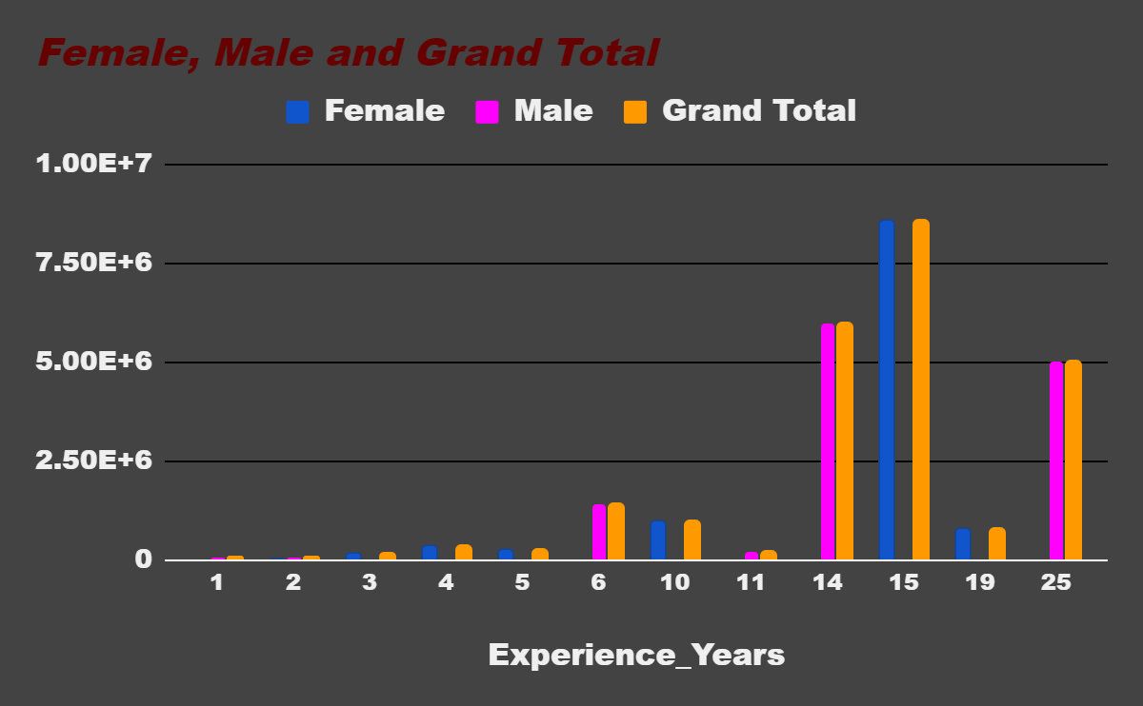
RESULTS pivot Table chart
SUM of Salary | Gender
Experience_Years | Female | Male | Grand Total
1 |  | 60000 | 60000
2 | 9000 | 47500 | 56500
3 | 170000 |  | 170000
4 | 337000 |  | 337000
5 | 250000 |  | 250000
6 |  | 1400000 | 1400000
10 | 991500 |  | 991500
11 |  | 220100 | 220100
14 |  | 6000050 | 6000050
15 | 8550000 |  | 8550000
19 | 800000 |  | 800000
25 |  | 5001000 | 5001000
Grand Total | 11107500 | 12728650 | 23836150
11

Slide 12
conclusion
.
Total Salaries:
Females: $11,107,500
Males: $12,728,650
Overall Total: $23,836,150
Males have earned more overall compared to females.
Salary by Experience:
Females earn significantly in Experience 6 Years ($1,400,000) and Experience 10 Years ($991,500).
Males have higher earnings in Experience 14 Years ($6,000,050), Experience 15 Years ($8,550,000), and Experience 25 Years ($5,001,000).
This shows that males earn more in the higher experience categories, while females earn more in specific lower experience categories.
Trend:
Generally, males earn more in longer career spans, while females achieve higher earnings in certain mid-career experience ranges.
In summary, while females have strong earnings in some experience ranges, have higher total earnings overall, particularly in longer career spans.

